Slide 1
Clustering Highly Conserved Phylogenetic Markers
Christopher Hill
Advisor: Mihai Pop
Preliminary Exam
May 15th, 2014
Notes:
No guarantees
Arbitrary cutoffs

Slide 2
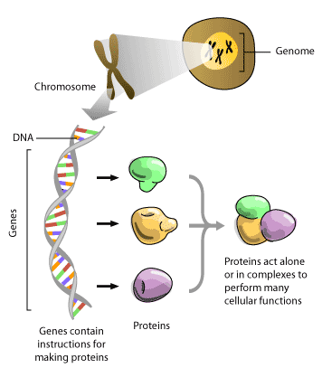

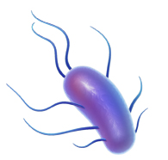
x 10¹³
x 10¹⁴
Bacteria
Wooley, John C., Adam Godzik, and Iddo Friedberg. "A primer on metagenomics." PLoS computational biology 6.2 (2010): e1000667.
http://www.3dscience.com/img/Products/Images/clip_art/bacteria_flagellae_web.jpg
http://www.scq.ubc.ca/wp-content/uploads/2006/08/molecular-machine.gif

Slide 3

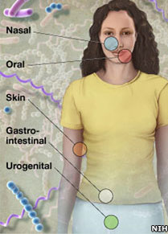
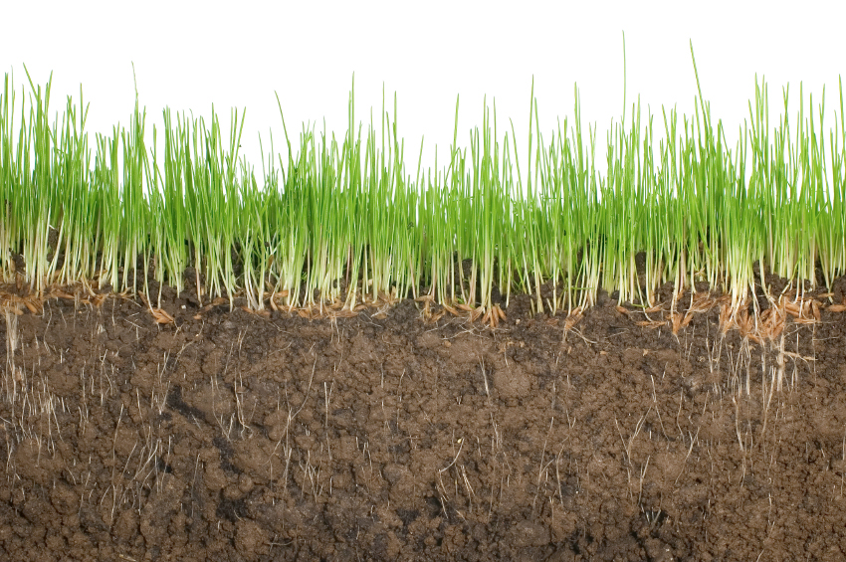
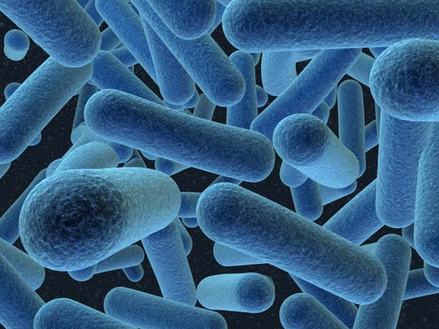
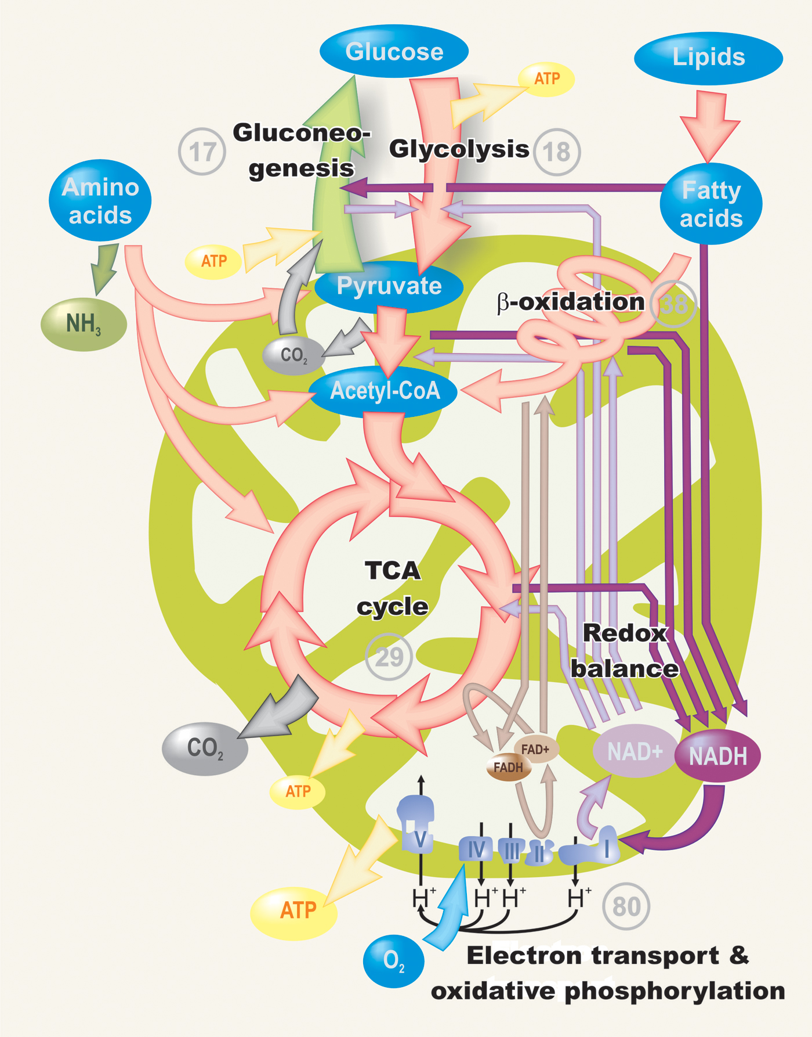
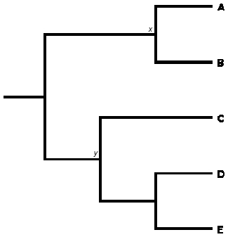
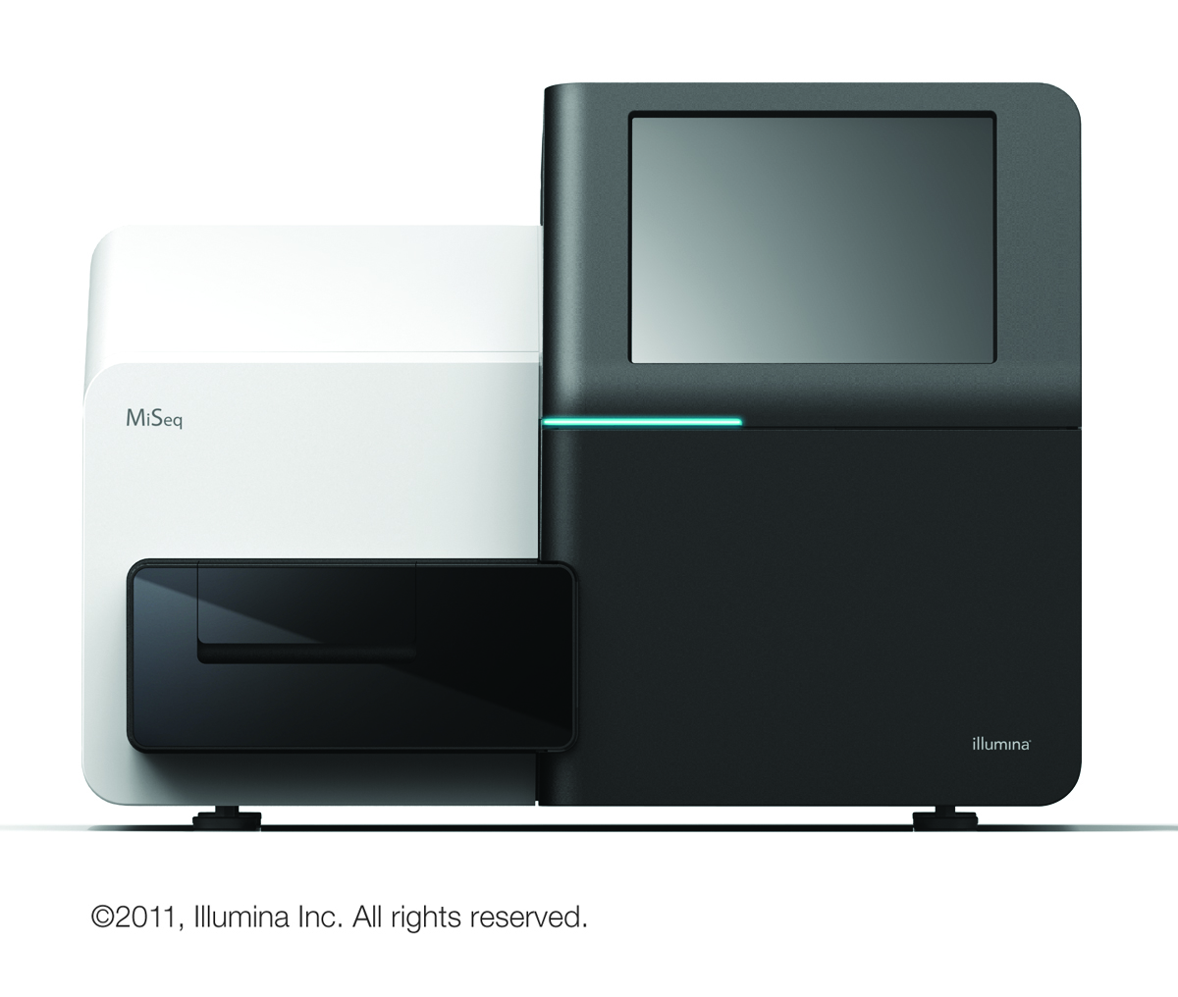
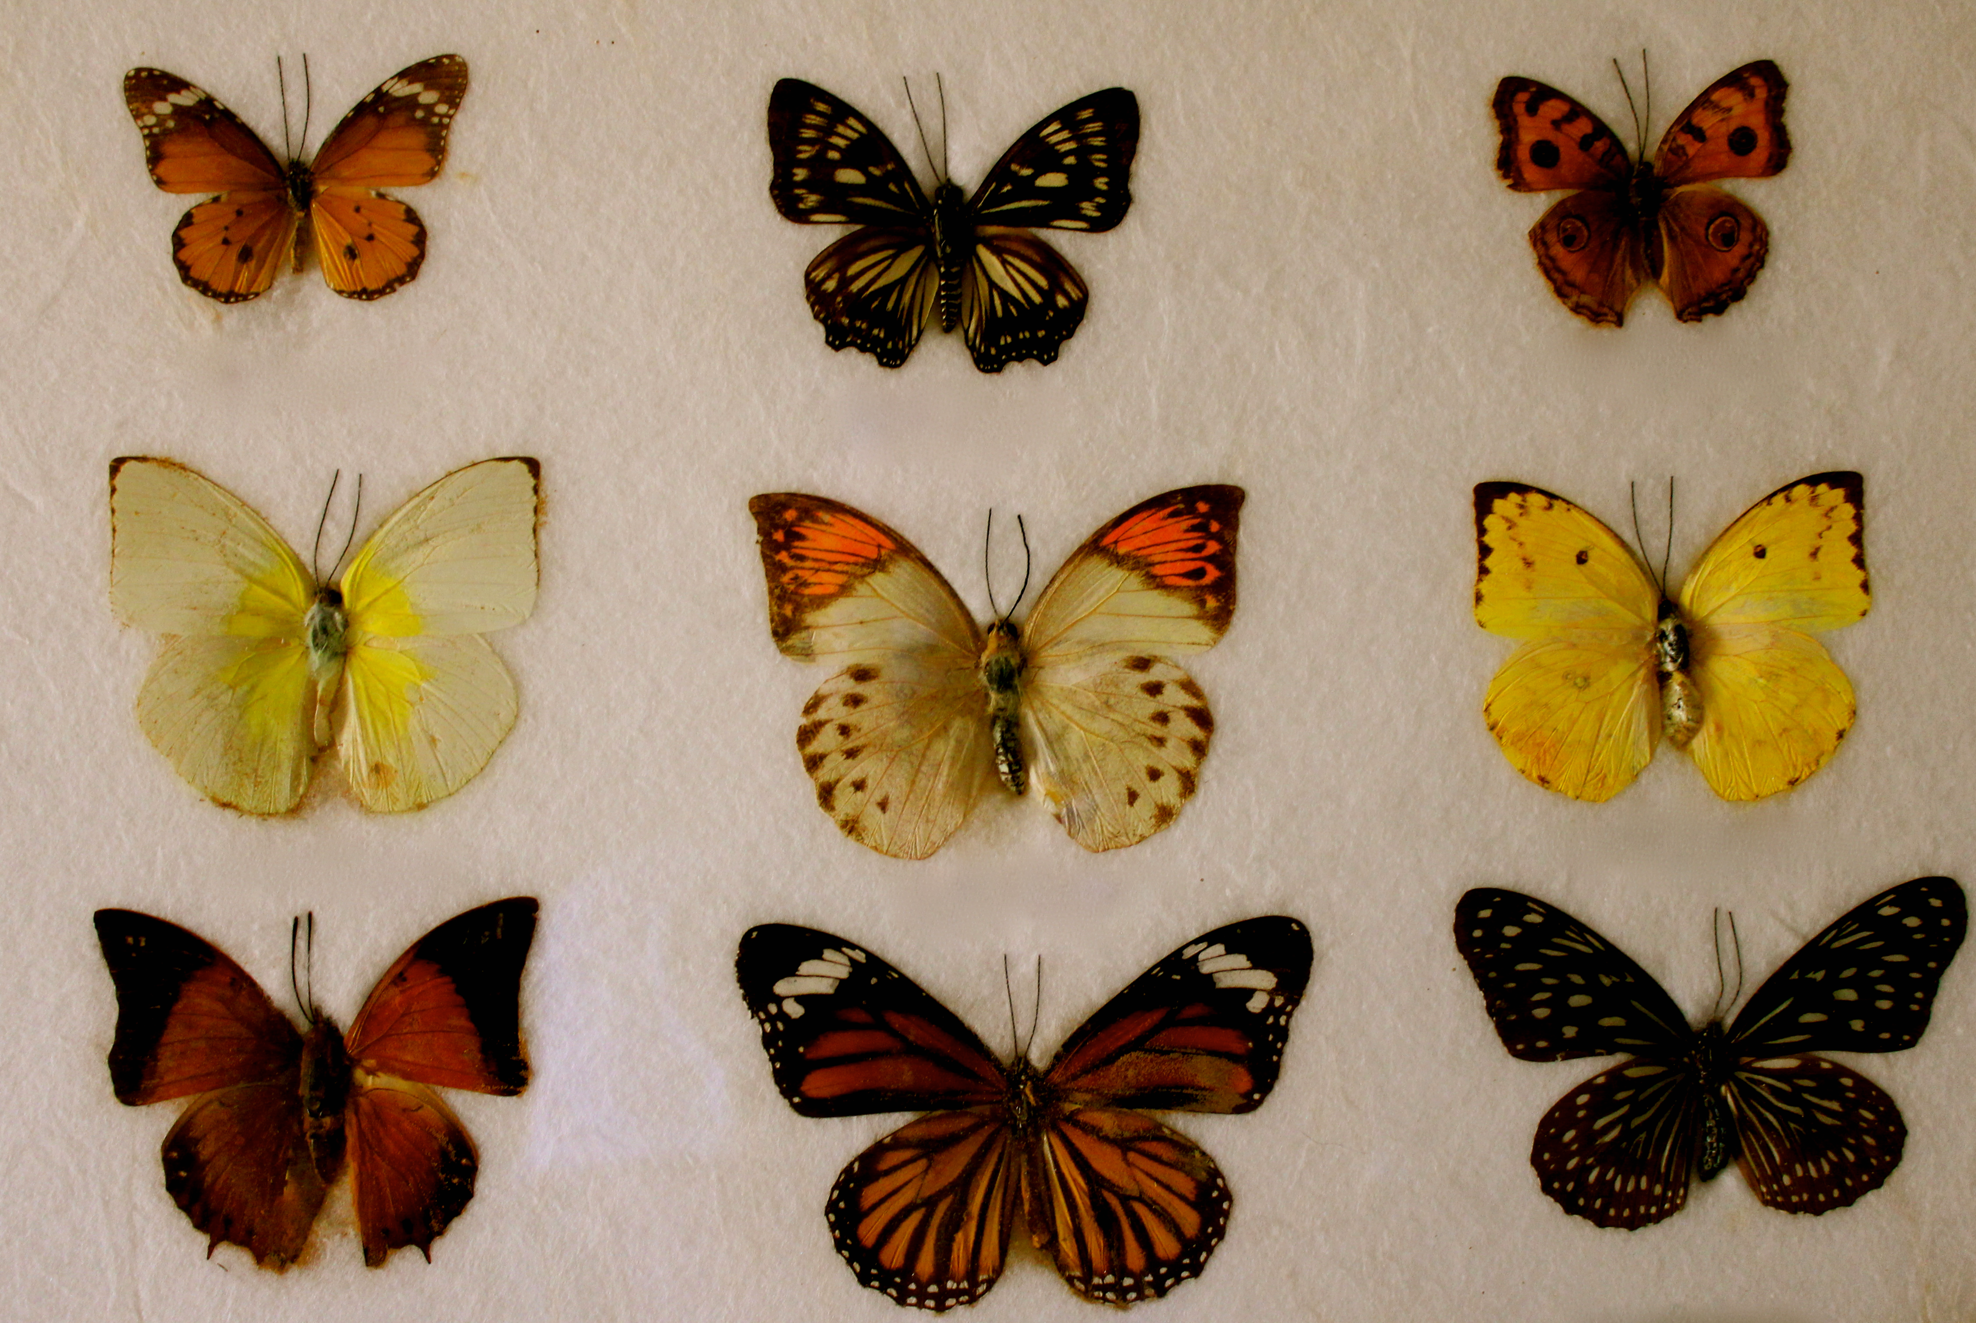
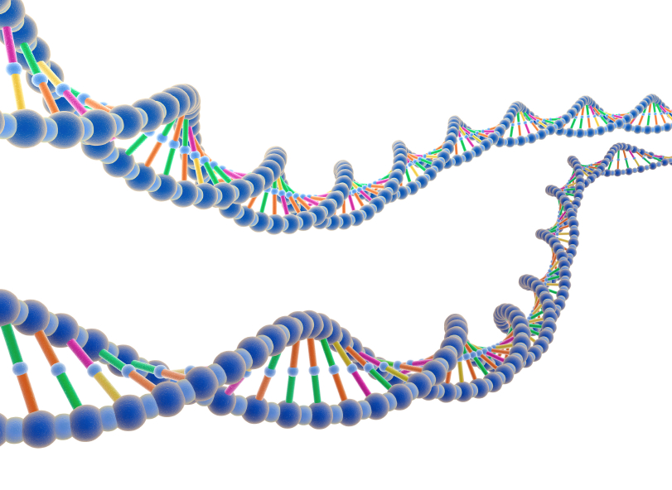
Environmental sample
Metagenomics
Filtering
>seq_1
ATCTGCTGGC
>seq_2
TTCTGGTACT
http://static.guim.co.uk/sys-images/Guardian/Pix/pictures/2012/9/26/1348685373327/Southern-Ocean-010.jpg
http://news.bbcimg.co.uk/media/images/60893000/jpg/_60893806_body.jpg
http://www.randyslawnservice.com/images/grass%20and%20soil.jpg
http://blogs.discovermagazine.com/loom/2010/03/04/i-for-one-welcome-our-microbial-overlords/#.U2vcMa1dWn0
http://blogs-images.forbes.com/matthewherper/files/2011/01/Illumina_MiSeqTM_CopyRight2011.jpg
http://ingridbrowning.com/wp-content/uploads/2011/08/IMG_3658.jpg
Sequencing
Analysis
Notes:
----- Meeting Notes (5/9/14 15:09) -----
De novo reference
How many different kinds of bacteria
Perfect world get whole sequence

Slide 4
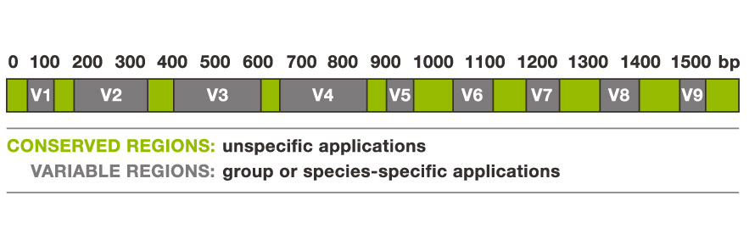
16S rRNA gene
AAATTGAAG..
Online 16S databases:
SILVA
RDB
Greengenes
Tortoli, Enrico. "Impact of genotypic studies on mycobacterial taxonomy: the new mycobacteria of the 1990s." Clinical microbiology reviews 16.2 (2003): 319-354.

Slide 5
Targeted sequencing
Whole genome shotgun sequencing
Genomic DNA
Genomic DNA
Genomic DNA
Genomic DNA
Genomic DNA
Genomic DNA
Genomic DNA
Genomic DNA
Sequencing Error
http://www.alimetrics.net/en/images/stories/content/M_00-06%20DNA%20based%20kuva%203.jpg
Notes:
Green genes, silva
----- Meeting Notes (5/9/14 15:09) -----
Which regions we attend to use.
Characterize variable regions
Ill change the picture
V1-V3, V3-V5

Slide 6
Genomic DNA
Genomic DNA
Targeted sequencing
Whole genome shotgun sequencing
Genomic DNA
Genomic DNA
Genomic DNA
Genomic DNA
Genomic DNA
Genomic DNA
Genomic DNA
Genomic DNA
Sequencing Error
http://www.alimetrics.net/en/images/stories/content/M_00-06%20DNA%20based%20kuva%203.jpg
Notes:
Green genes, silva
----- Meeting Notes (5/9/14 15:09) -----
Which regions we attend to use.
Characterize variable regions
Ill change the picture
V1-V3, V3-V5

Slide 7
Sequencing Error
Species-specific SNP
x 6
x 3
Input
Cluster
Count

Slide 8
16S
16S
16S
…
16S
16S
16S
16S
16S
16S
16S
16S
16S
16S
16S
16S
16S
16S
16S
16S
16S
16S
16S
16S rRNA targeted sequencing
Whole genome shotgun (WGS)
sequencing
Notes:
----- Meeting Notes (5/9/14 15:09) -----
Coverage can't assemble
Objective,

Slide 9

Part I: Fast k-difference alignment
X 100,000,000
Part 2: Multi-core clustering
Part 3: Ambiguous assignment
?

Slide 10
Clustering
Notes:
----- Meeting Notes (5/9/14 15:09) -----
Population, clustering differences, why cluster 16s

Slide 11
Hierarchical
Divisive
(Top-down)
Agglomerative
(Bottom-up)
Often O(n³) time, but more efficient algorithms exist.
Notes:
----- Meeting Notes (5/9/14 15:09) -----
Three different shapes

Slide 12
Greedy clustering
1. Select a cluster center.
3. Repeat until no more
sequences remain.
2. Recruit sequences to center.

Slide 13
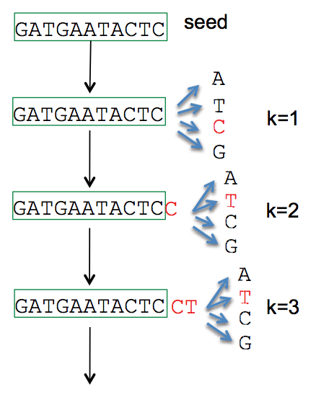
1. Select a cluster center.
Length | Abundance | k-mers
Longest remaining sequence
Run fast deduplication
…
CD-HIT (Li et al. 2006)
UCLUST (Edgar 2010) DNACLUST (Ghodsi et al. 2011)
UCLUST (Edgar 2010)
AbundantOTU (Ye 2010)

Slide 14
2. Recruit sequences to center.
Edit (Levenshtein) distance
Similarity
ATGTGA
x|||x|
-TGTCA
Substitutions, insertions, deletions
K-mer distance
k=2 AA AC AG AT .. TG TT
ATGTGA: [0 0 0 1 .. 2 0]
-TGTCA: [0 0 0 0 .. 1 0]
Notes:
Fractional common k-mer count: For the last measure, the distance is computed based on the minimum count of every k-mer in the two sequences, thus if two sequences are very different, the minimums will all be small.
Identiy
----- Meeting Notes (5/9/14 15:09) -----
Characters
TGTG - 2
Add gap character
Distances
challenges

Slide 15
How to calculate edit distance between:
AGGTATCGC and ATGGC?
Problem
Dynamic programming
Solution

Slide 16
Break down problem into easier sub-problems
Dynamic Programming
M(n,m) – Table storing solutions to sub-problems for aligning pattern and the text of lengths n and m, respectively.
Text (t)
 |  | 0 | 1 | 2 | 3 | 4 | 5 | 6 | 7 | 8 | 9
 | M | - | A | G | G | T | A | T | C | G | C
0 | - | 0 | 1 | 2 | 3 | 4 | 5 | 6 | 7 | 8 | 9
1 | A | 1
2 | T | 2
3 | G | 3
4 | G | 4
5 | C | 5
Pattern (p)
M(i,j) – minimum edit distance of aligning pattern_{0..i} to text_{0..j}
Compute M(i,j) using previously computed smaller values!
Notes:
----- Meeting Notes (5/9/14 15:09) -----
Subproblems have a specific set
Recursively

Slide 17
Text (t)
 |  | 0 | 1 | 2 | 3 | 4 | 5 | 6 | 7 | 8 | 9
 | M | - | A | G | G | T | A | T | C | G | C
0 | - | 0 | 1 | 2 | 3 | 4
1 | A | 1 | 0 | 1 | 2 | 3
2 | T | 2 | 1 | 1 | 2 | ?
3 | G | 3 | 2 | 1 | 1
4 | G | 4 | 3 | 2 | 1
5 | C | 5 | 4 | 3 | 2
Pattern (p)
AGGT
A-T-
Align p_{0..2} to t_{0..3} + gap in p
M(2,4) =
min
AGGT-
A---T
Align p_{0..1} to t_{0..4} + gap in t
Align p_{0..1} to t_{0..3} + cost(‘T’,’T’)
AGGT
A--T
M(2,4) =
2

Slide 18
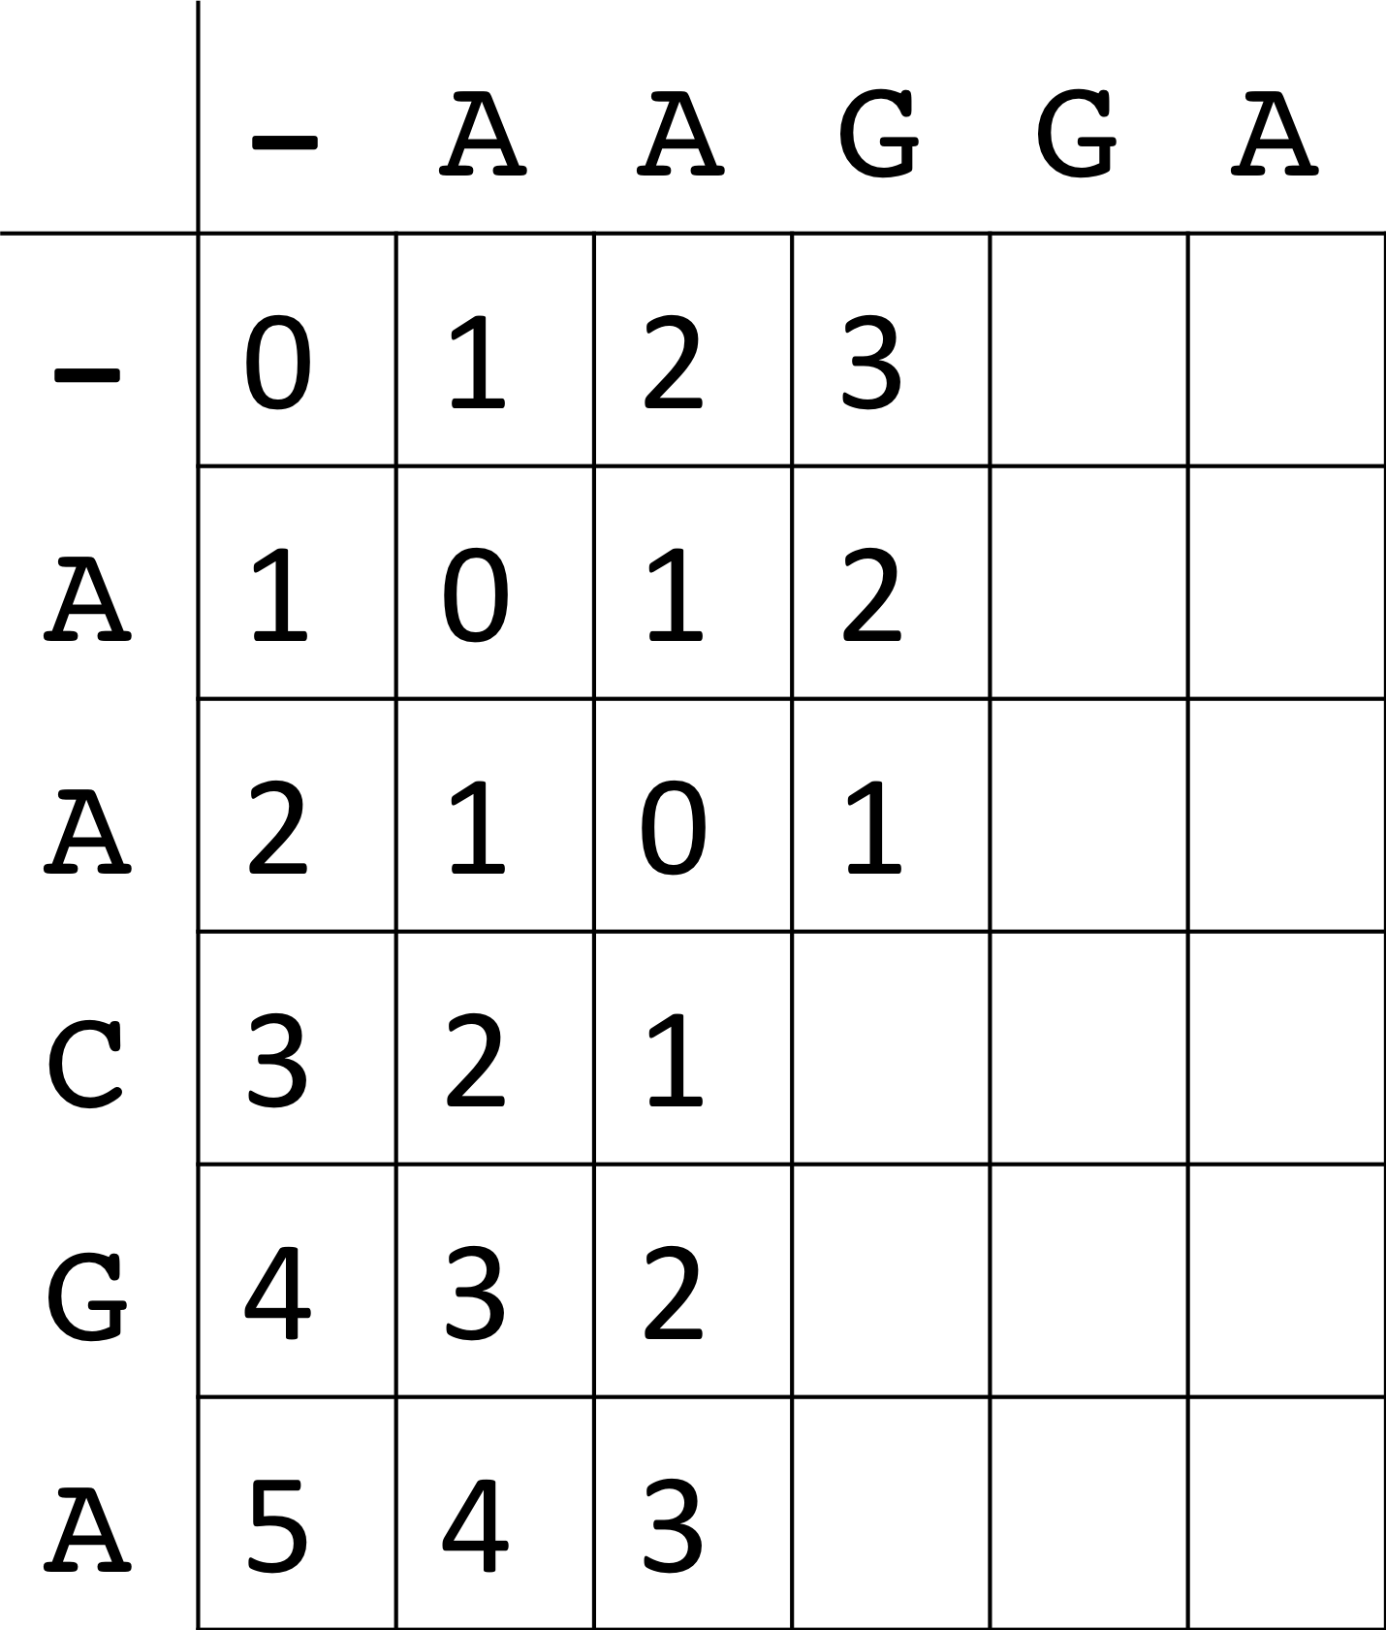
d
q
Optimal edit distance will
be located M_{ij}
O(n*m) time and memory
Notes:
----- Meeting Notes (5/9/14 15:09) -----
levenstein distance
M_nm

Slide 19
Global alignment
Semi-global alignment
 |  | 0 | 1 | 2 | 3 | 4 | 5 | 6 | 7 | 8 | 9
 | M | - | A | G | G | T | A | T | C | G | C
0 | - | 0 | 1 | 2 | 3 | 4 | 5 | 6 | 7 | 8 | 9
1 | A | 1 | 0 | 1 | 2 | 3 | 4 | 5 | 6 | 7 | 8
2 | T | 2 | 1 | 1 | 2 | 2 | 3 | 4 | 5 | 6 | 7
3 | G | 3 | 2 | 1 | 1 | 2 | 3 | 4 | 5 | 5 | 6
4 | G | 4 | 3 | 2 | 1 | 2 | 3 | 4 | 5 | 5 | 6
5 | C | 5 | 4 | 3 | 2 | 2 | 3 | 4 | 4 | 5 | 5
 |  | 0 | 1 | 2 | 3 | 4 | 5 | 6 | 7 | 8 | 9
 | M | - | A | G | G | T | A | T | C | G | C
0 | - | 0 | 0 | 0 | 0 | 0 | 0 | 0 | 0 | 0 | 0
1 | A | 1 | 0 | 1 | 1 | 1 | 0 | 1 | 1 | 1 | 1
2 | T | 2 | 1 | 1 | 2 | 1 | 1 | 0 | 1 | 2 | 2
3 | G | 3 | 2 | 1 | 1 | 2 | 2 | 1 | 1 | 1 | 2
4 | G | 4 | 3 | 2 | 1 | 2 | 3 | 2 | 2 | 1 | 2
5 | C | 5 | 4 | 3 | 2 | 2 | 3 | 3 | 2 | 2 | 1
AGGTATCGC
ATG----GC
AGGTATCGC
ATGGC
O(n*m) time and memory
Notes:
----- Meeting Notes (5/9/14 15:09) -----
highly conservative markers - 16s

Slide 20
What if we want to limit the amount of edits?
For example, k = 2?
Global alignment
Semi-global alignment
 |  | 0 | 1 | 2 | 3 | 4 | 5 | 6 | 7 | 8 | 9
 | M | - | A | G | G | T | A | T | C | G | C
0 | - | 0 | 1 | 2 | 3 | 4 | 5 | 6 | 7 | 8 | 9
1 | A | 1 | 0 | 1 | 2 | 3 | 4 | 5 | 6 | 7 | 8
2 | T | 2 | 1 | 1 | 2 | 2 | 3 | 4 | 5 | 6 | 7
3 | G | 3 | 2 | 1 | 1 | 2 | 3 | 4 | 5 | 5 | 6
4 | G | 4 | 3 | 2 | 1 | 2 | 3 | 4 | 5 | 5 | 6
5 | C | 5 | 4 | 3 | 2 | 2 | 3 | 4 | 4 | 5 | 5
 |  | 0 | 1 | 2 | 3 | 4 | 5 | 6 | 7 | 8 | 9
 | M | - | A | G | G | T | A | T | C | G | C
0 | - | 0 | 0 | 0 | 0 | 0 | 0 | 0 | 0 | 0 | 0
1 | A | 1 | 0 | 1 | 1 | 1 | 0 | 1 | 1 | 1 | 1
2 | T | 2 | 1 | 1 | 2 | 1 | 1 | 0 | 1 | 2 | 2
3 | G | 3 | 2 | 1 | 1 | 2 | 2 | 1 | 1 | 1 | 2
4 | G | 4 | 3 | 2 | 1 | 2 | 3 | 2 | 2 | 1 | 2
5 | C | 5 | 4 | 3 | 2 | 2 | 3 | 3 | 2 | 2 | 1
O(k*n) time and memory
O(n*m) time and memory!
Notes:
----- Meeting Notes (5/9/14 15:09) -----
Philosophical, time

Slide 21
Landau-Vishkin k-difference algorithm
Traditional dynamic programming table
 |  | 0 | 1 | 2 | 3 | 4 | 5 | 6 | 7 | 8 | 9
 | M | - | A | G | G | T | A | T | C | G | C
0 | - | 0 | 0 | 0 | 0 | 0 | 0 | 0 | 0 | 0 | 0
1 | A | 1 | 0 | 1 | 1 | 1 | 0 | 1 | 1 | 1 | 1
2 | T | 2 | 1 | 1 | 2 | 1 | 1 | 0 | 1 | 2 | 2
3 | G | 3 | 2 | 1 | 1 | 2 | 2 | 1 | 1 | 1 | 2
4 | G | 4 | 3 | 2 | 1 | 2 | 3 | 2 | 2 | 1 | 2
5 | C | 5 | 4 | 3 | 2 | 2 | 3 | 3 | 2 | 2 | 1
Intuition: For each diagonal in M, store the last column before the edit number changes.
O(k*m) time and memory!
d = 2
Alternate dynamic programming table
 |  |  |  |  |  |  | d
 | C | -3 | -2 | -1 | 0 | 1 | 2 | 3 | 4 | 5 | 6 | 7
 | -1 |  |  | -∞ | -1 | 0 | 1 | 2 | 3 | 4 | 5 | 6
 | 0 |  | -∞ | -1 | 1 | 1 | 2 | 3 | 6 | 5 | 6
e | 1 | -∞ | -1 | 3 | 3 | 2 | 4 | 6 | 9 | 8
 | 2 | -1 | 3 | 4 | 4 | 4 | 7 | 8 | 9
C(e,d) = last column in M on d-diagonal that contains e edits.
C(1,2) = 4

Slide 22
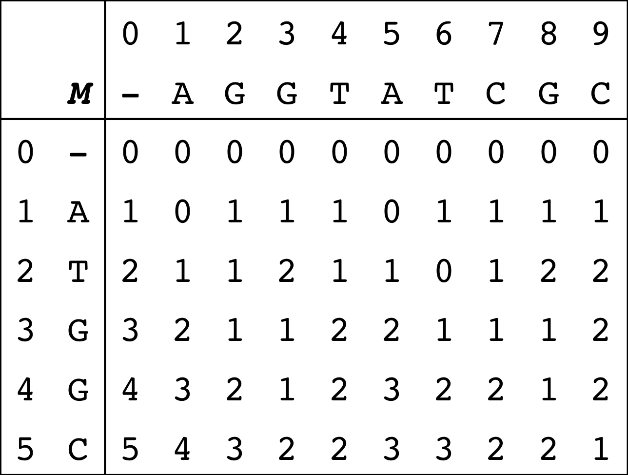
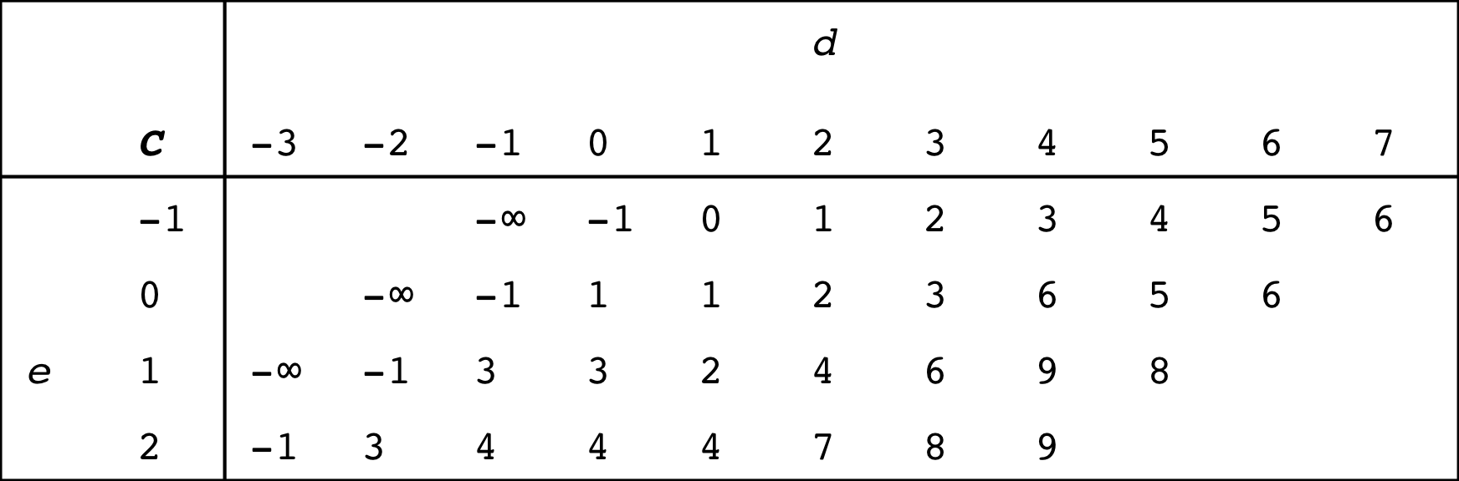
Traditional dynamic programming table
Semi-global alignment
Alternate dynamic programming table
C(e,d) = last column in M on d-diagonal that contains e edits.
C(1,2) = 1
d = 2
O(k*m) time*
and memory!
Notes:
----- Meeting Notes (5/9/14 15:09) -----
red square wrong
edit distance
c(1,2) = 4

Slide 23
TODO: Farthest reaching d-path
Explain Landau-Vishkin algorithm
How to fill out the matrix

Slide 24
Preliminary Results
Dataset:
1,000 randomly chosen 16S rRNA sequences from HMP (600-300bp).
Center:
Randomly select 10 sequences to serve as centers.
 | Semi-global (k=5)
Naïve | 1.102 sec
Landau-Vishkin | 0.0332 sec
Speedup | 33.2x
Runtimes averaged over 100 runs.

Slide 25
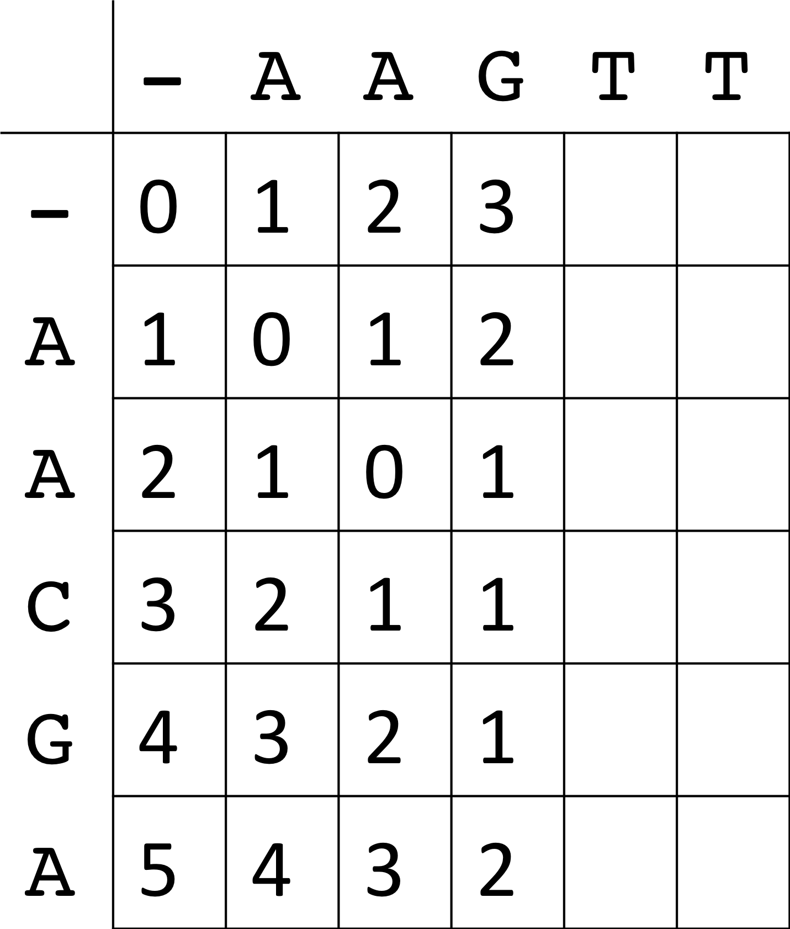
d1
d2
q
q
In DNACLUST, sequences are stored sorted so we can reuse parts from the previous dynamic programming table.

Slide 26
In DNACLUST, sequences are stored sorted so we can reuse parts from the previous dynamic programming table.
 |  | 0 | 1 | 2 | 3 | 4 | 5 | 6 | 7 | 8 | 9
 | M | - | A | G | G | T | A | T | C | G | C
0 | - | 0 | 0 | 0 | 0 | 0 | 0 | 0 | 0 | 0 | 0
1 | A | 1 | 0 | 1 | 1 | 1 | 0 | 1 | 1 | 1 | 1
2 | T | 2 | 1 | 1 | 2 | 1 | 1 | 0 | 1 | 2 | 2
3 | G | 3 | 2 | 1 | 1 | 2 | 2 | 1 | 1 | 1 | 2
4 | G | 4 | 3 | 2 | 1 | 2 | 3 | 2 | 2 | 1 | 2
5 | C | 5 | 4 | 3 | 2 | 2 | 3 | 3 | 2 | 2 | 1
 |  | 0 | 1 | 2 | 3 | 4 | 5 | 6 | 7 | 8 | 9
 | M | - | A | G | G | T | A | T | C | G | C
0 | - | 0 | 0 | 0 | 0 | 0 | 0 | 0 | 0 | 0 | 0
1 | A | 1 | 0 | 1 | 1 | 1 | 0 | 1 | 1 | 1 | 1
2 | T | 2 | 1 | 1 | 2 | 1 | 1 | 0 | 1 | 2 | 2
3 | T
4 | A
5 | A
Previous sequence: ATGGC
New sequence: ATTAA
Longest common prefix: 2
Notes:
Traditional table

Slide 27
 |  | 0 | 1 | 2 | 3 | 4 | 5 | 6 | 7 | 8 | 9
 | M | - | A | G | G | T | A | T | C | G | C
0 | - | 0 | 0 | 0 | 0 | 0 | 0 | 0 | 0 | 0 | 0
1 | A | 1 | 0 | 1 | 1 | 1 | 0 | 1 | 1 | 1 | 1
2 | T | 2 | 1 | 1 | 2 | 1 | 1 | 0 | 1 | 2 | 2
3 | G | 3 | 2 | 1 | 1 | 2 | 2 | 1 | 1 | 1 | 2
4 | G | 4 | 3 | 2 | 1 | 2 | 3 | 2 | 2 | 1 | 2
5 | C | 5 | 4 | 3 | 2 | 2 | 3 | 3 | 2 | 2 | 1
 |  |  |  |  |  |  | d
 | C | -3 | -2 | -1 | 0 | 1 | 2 | 3 | 4 | 5 | 6 | 7
 | -1 |  |  | -∞ | -1 | 0 | 1 | 2 | 3 | 4 | 5 | 6
 | 0 |  | -∞ | -1 | 1 | 1 | 2 | 3 | 6 | 5 | 6
e | 1 | -∞ | -1 | 3 | 3 | 2 | 4 | 6 | 9 | 8
 | 2 | -1 | 3 | 4 | 4 | 4 | 7 | 8 | 9

Slide 28
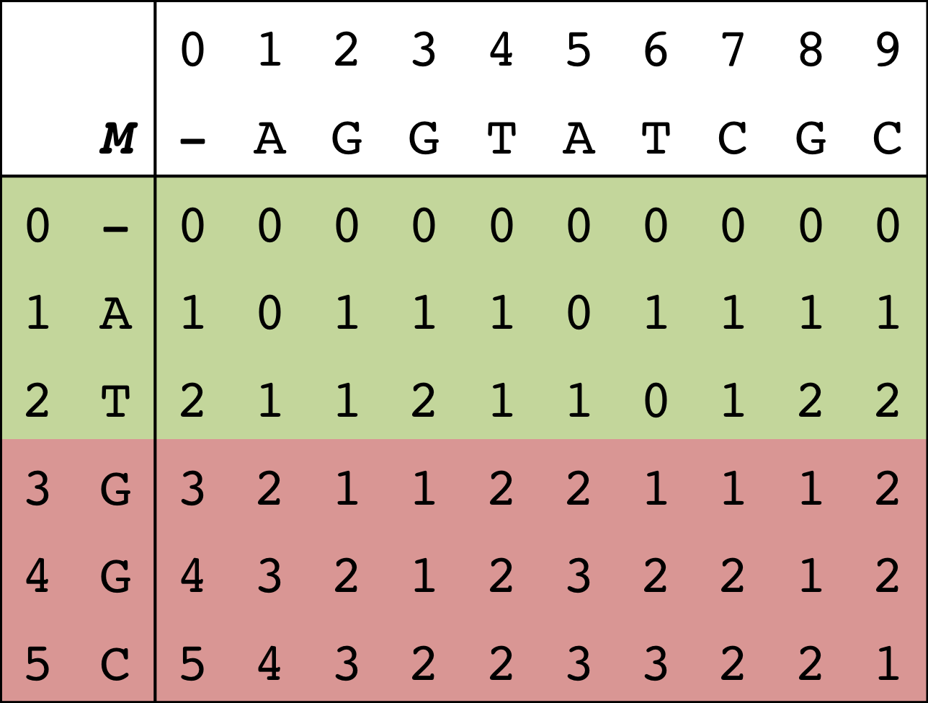
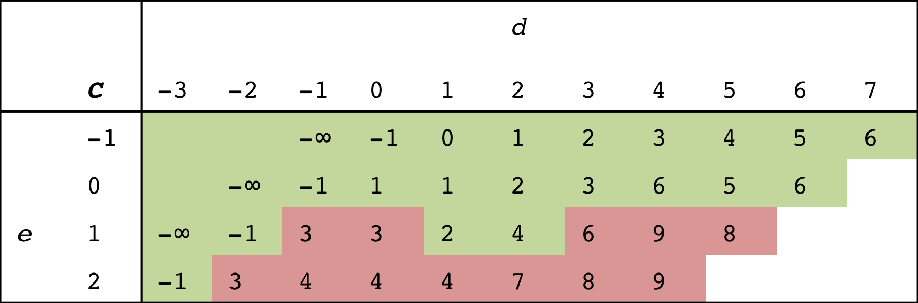
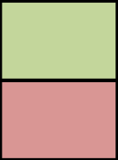
How do we exploit this property in the alternative representation?
Previous sequence: ATGGC
New sequence: ATTAA
LCP: 2
Traditional dynamic programming table
Can reuse
Need to recompute
Alternate dynamic programming table

Slide 29
Notes:
----- Meeting Notes (5/9/14 15:09) -----
Put formula in there

Slide 31
Notes:
----- Meeting Notes (5/9/14 15:09) -----
Put proof

Slide 32
O(k + n) work to reuse previous matrix.

Slide 33
X 100,000,000
Part 2: Multi-core clustering

Slide 34
1. Select a cluster center.
3. Repeat until no more
sequences remain.
2. Recruit sequences to center.
Center:
CATGCTGCCTCCCGTAGGAGGTGGGCTTCCTC
CATGCTGCCTC..GCTTCCTC
CATGTTGCCTC..GCTTCCTC
CATGTTGCCTC..GCTTCCTC
CATTTTGCCTC..GCTTTTTC
CATTTTGCCTC..GCTTTTTC
CATTTTGCCTC..GCTTTTTC
CGTGTTGCCTC..GCTTCCTC
CCTGTTGCCTC..GCTTCCTC
Sequences:

Slide 35
1. Select a cluster center.
3. Repeat until no more
sequences remain.
2. Recruit sequences to center.
Center:
CATGCTGCCTCCCGTAGGAGGTGGGCTTCCTC
CATGCTGCCTC..GCTTCCTC
CATGTTGCCTC..GCTTCCTC
CATGTTGCCTC..GCTTCCTC
CATTTTGCCTC..GCTTTTTC
CATTTTGCCTC..GCTTTTTC
CATTTTGCCTC..GCTTTTTC
CGTGTTGCCTC..GCTTCCTC
CCTGTTGCCTC..GCTTCCTC
Sequences:

Slide 36
1. Select a cluster center.
3. Repeat until no more
sequences remain.
2. Recruit sequences to center.
Center:
CATGCTGCCTCCCGTAGGAGGTGGGCTTCCTC
CATGCTGCCTC..GCTTCCTC
CATGTTGCCTC..GCTTCCTC
CATGTTGCCTC..GCTTCCTC
CATTTTGCCTC..GCTTTTTC
CATTTTGCCTC..GCTTTTTC
CATTTTGCCTC..GCTTTTTC
CGTGTTGCCTC..GCTTCCTC
CCTGTTGCCTC..GCTTCCTC
Sequences:

Slide 37
1. Select a cluster center.
3. Repeat until no more
sequences remain.
2. Recruit sequences to center.
Center:
CATGCTGCCTCCCGTAGGAGGTGGGCTTCCTC
CATGCTGCCTC..GCTTCCTC
CATGTTGCCTC..GCTTCCTC
CATGTTGCCTC..GCTTCCTC
CATTTTGCCTC..GCTTTTTC
CATTTTGCCTC..GCTTTTTC
CATTTTGCCTC..GCTTTTTC
CGTGTTGCCTC..GCTTCCTC
CCTGTTGCCTC..GCTTCCTC
Sequences:
Notes:
And it goes on.

Slide 38
1. Select a cluster center.
3. Repeat until no more
sequences remain.
2. Recruit sequences to center.
Center:
CATGCTGCCTCCCGTAGGAGGTGGGCTTCCTC
CATGCTGCCTC..GCTTCCTC
CATGTTGCCTC..GCTTCCTC
CATGTTGCCTC..GCTTCCTC
CATTTTGCCTC..GCTTTTTC
CATTTTGCCTC..GCTTTTTC
CATTTTGCCTC..GCTTTTTC
CGTGTTGCCTC..GCTTCCTC
CCTGTTGCCTC..GCTTCCTC
Sequences:

Slide 39
1. Select a cluster center.
3. Repeat until no more
sequences remain.
2. Recruit sequences to center.
Center:
CATGCTGCCTCCCGTAGGAGGTGGGCTTCCTC
CATGCTGCCTC..GCTTCCTC
CATGTTGCCTC..GCTTCCTC
CATGTTGCCTC..GCTTCCTC
CATTTTGCCTC..GCTTTTTC
CATTTTGCCTC..GCTTTTTC
CATTTTGCCTC..GCTTTTTC
CGTGTTGCCTC..GCTTCCTC
CCTGTTGCCTC..GCTTCCTC
Sequences:

Slide 40
1. Select a cluster center.
3. Repeat until no more
sequences remain.
2. Recruit sequences to center.
Center:
CATGCTGCCTCCCGTAGGAGGTGGGCTTCCTC
CATGCTGCCTC..GCTTCCTC
CATGTTGCCTC..GCTTCCTC
CATGTTGCCTC..GCTTCCTC
CATTTTGCCTC..GCTTTTTC
CATTTTGCCTC..GCTTTTTC
CATTTTGCCTC..GCTTTTTC
CGTGTTGCCTC..GCTTCCTC
CCTGTTGCCTC..GCTTCCTC
Sequences:

Slide 41
Notes:
Quasi-linear speedup.
1.5x faster when doubling the threads

Slide 42
Sorted sequences create an implicit trie data structure.
Adjacent sequences sharing a common prefix to speed up edit distance computation.
CTG…
AT
ATGCTGCCTC..GCTTCCTC
ATGTTGCCTC..GCTTCCTC
ATGTTGCCTC..GCTTCCTC
ATGTTGCCTC..GCTTCCTC
ATTTTGCCTC..GCTTTTTC
ATTTTGCCTC..GCTTTTTC
ATTTTGCCTC..GCTTTTTC
CTGTTGCCTC..GCTTCCTC
TT…
G
TTG…
CTG…
Trie length: Sum of all edge lengths

Slide 43
Trie
length
Trie
length
AAAAAAAAAA
AAAAAAAAAA
AAAAAAAAAA
AAAAAAAAAA
AAAAAAAAAA
AAAAAAAAAA
AAAAAAAAAA
CCCCCCCCCC
GGGGGGGGGG
TTTTTTTTTT
AAAAAAAAAA
AAAAAAAAAA
AAAAAAAAAA
AAAAAAAAAA
AAAAAAAAAA
AAAAAAAAAA
AAAAAAAAAA
CCCCCCCCCC
GGGGGGGGGG
TTTTTTTTTT
10
20
40
20
Naïve
Work-based

Slide 44
Part 3: Ambiguous assignment
?

Slide 45
Problem

Slide 46

Random
Uniquely alignable reads only
?
Flip a coin
Assign reads based on
proportion of unique reads
Fractional counts
0.5
0.5
66%
33%
http://www.psdgraphics.com/file/recycling-bin-icon.jpg

Slide 47
Part I: Fast k-difference alignment
X 100,000,000
Part 2: Multi-core clustering
Part 3: Ambiguous assignment
?

Slide 48
Hidden

Slide 49
Acknowledgements
TBA

